Slide 1
Android Content
Providers

Slide 2
Content Providers
Private data stored on behalf of an application could be of benefit to other applications.
Eg: data stored by the built-in Contacts application on an Android device.
While the Contacts application is primarily responsible for the management of the user’s address book details, this data is also made accessible to any other applications that might need access to this data.
This sharing of data between Android applications is achieved through the implementation of content providers

Slide 3
What is a Content Provider?
A content provider provides access to structured data between different Android applications.
This data is exposed to applications
Either as tables of data (in much the same way as a SQLite database) or as a handle to a file.
Involves the implementation of a client/server arrangement
Application seeking access to the data is the client
Content provider is the server, performing actions and returning results on behalf of the client.

Slide 4
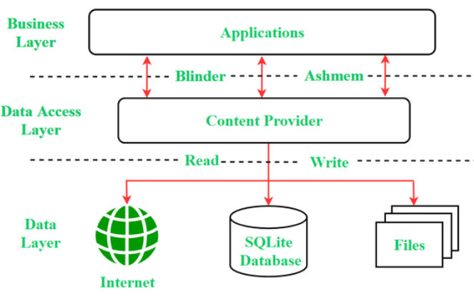

Slide 5
The Content Provider
A content provider is created as a subclass of the android.content.ContentProvider class.
Involves the implementation of a set of methods to manage the data on behalf of other, client applications.
These methods are:
onCreate(): Called when the content provider is first created and should be used to perform any initialization tasks required by the content provider.

Slide 6
The Content Provider
query(): Called when a client requests that data be retrieved from the content provider.
It is the responsibility of this method to identify the data to be retrieved (either single or multiple rows), perform the data extraction and return the results wrapped in a Cursor object.
insert(): Called when a new row needs to be inserted into the provider database.
This method must identify the destination for the data, perform the insertion and return the full URI of the newly added row.

Slide 7
The Content Provider
update(): Called when existing rows need to be updated on behalf of the client.
The method uses the arguments passed through to update the appropriate table rows and return the number of rows updated as a result of the operation.
delete(): Called when rows are to be deleted from a table.
This method deletes the designated rows and returns a count of the number of rows deleted.

Slide 8
The Content Provider
getType():
Returns the MIME type of the data stored by the content provider.

Slide 9
The Content URI
An Android device will potentially contain a number of content providers.
The system must provide some way of identifying one provider from another.
Similarly, a single content provider may provide access to multiple forms of content (typically in the form of database tables).
Client applications, therefore, need a way to specify the underlying data for which access is required.
This is achieved through the use of content URIs.

Slide 10
The Content URI
Content URI is essentially used to identify specific data within a specific content provider.
The Authority section of the URI identifies the content provider.
Usually takes the form of the package name of the content provider.
Eg: com.example.mydbapp.myprovider
A specific database table within the provider data structure may be referenced by appending the table name to the authority.
Eg: com.example.mydbapp.myprovider/products

Slide 11
The Content URI
A specific row within the specified table may be referenced by appending the row ID to the URI.
Eg: com.example.mydbapp.myprovider/products/3
References the row in the products table in which the value stored in the _ID column equals 3
UriMatcher class: Identify whether the incoming URI is targeting a specific row in a table, or references multiple rows

Slide 12
The Content Resolver
Access to a content provider is achieved via a ContentResolver object.
An application can obtain a reference to its content resolver by making a call to the getContentResolver() method of the application context.
The content resolver object contains a set of methods that mirror those of the content provider (insert, query, delete etc.).

Slide 13
The Content Resolver
The application simply makes calls to the methods, specifying the URI of the content on which the operation is to be performed.
The content resolver and content provider objects then communicate to perform the requested task on behalf of the application.

Slide 14
The <provider> Manifest Element
For a content provider to be visible within an Android system, it must be declared within the Android manifest file for the application in which it resides.
Achieved using the <provider> element, which must contain the following items:
android:authority – The full authority URI of the content provider.
For example com.example.mydbapp.mydbapp.myprovider
android:name – The name of the class that implements the content provider. In most cases, this will use the same value as the authority.

Slide 15
The <provider> Manifest Element
Similarly, the <provider> element may be used to define the permissions that must be held by client applications in order to qualify for access to the underlying data.
If no permissions are declared, the default behavior is for permission to be allowed for all applications.
Permissions can be set to cover the entire content provider, or limited to specific tables and records.

Slide 16
Implementing an Android Content
Provider in Android Studio

Slide 17
Copying the Database Project
Make a backup copy of the database project before modifying it to implement content provider support for the application.
Copy the Database project folder and rename as DatabaseOriginal. (or copy to a new folder)
Select the original Database project so that it loads into the main window.

Slide 18
Creating the Content Provider Class
Locate the package in the Project tool window, right-click on it and select the New -> Other -> Content Provider menu option.
In the Configure Component dialog, enter MyContentProvider into the Class Name field and the following into the URI Authorities field:
com.example.provider.MyContentProvider
Make sure that the new content provider class is both exported and enabled before clicking on Finish to create the new class.

Slide 19
Code for MyContentProvider.java is attached as separate file
Edit MainActivity.java to modify addStudent() and findStudent() methods (attached)
Drag and drop an additional TextView into the activity_main.xml

Slide 20
Exercises
Create an application that demonstrates Content Provider.
Create an application to retrieve and display contacts on your phone.

Slide 21
Thank You

